Slide 1
Lesson 6: Compensation Administration
Duration: 2 hours
Basic Pay Administration
Slide 6- 1

Slide 2
Lesson 6 Topics
Lesson 6 Topics
Topic 1 – Base Salary
Topic 2 – Local Market Supplements (LMS) and Targeted Local
Market Supplements (TLMS)
Topic 3 – DCIPS Annual Structure Adjustments
Topic 4 – Setting Pay
Topic 5 – Other Special Situations
Topic 6 – Foreign Language Proficiency Pay (FLPP)
Basic Pay Administration
Slide 6- 2

Slide 3
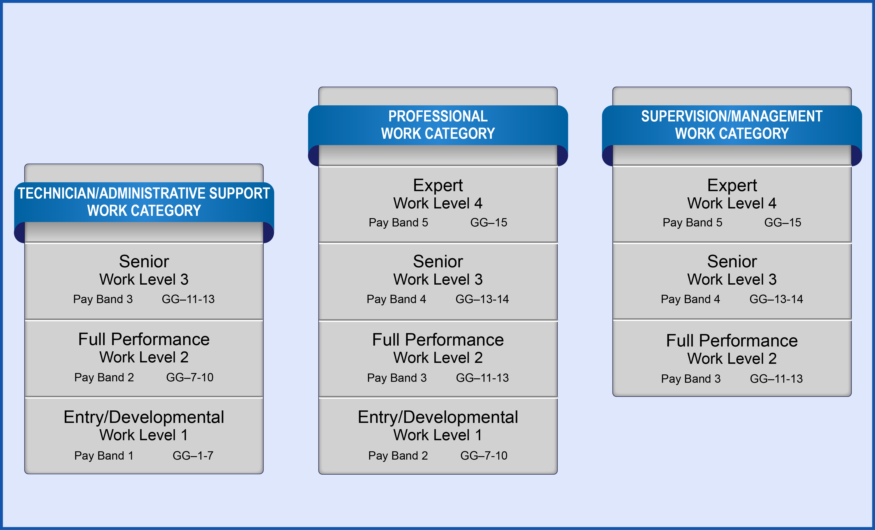
DCIPS Occupational Structure
DCIPS Occupational Structure
DCIPS Occupational Structure
Basic Pay Administration
Slide 6- 3

Slide 4
Basic Principles
Compensation System Basic Principles
Provides pay opportunities that enable flexible and effective recruitment, management, and retention of a high-quality, high-performing workforce
Promotes a high-performance culture
Recognizes employee performance and contributions to the mission
Focuses on total compensation
Basic Pay Administration
Slide 6- 4

Slide 5
Key Terms
Total Compensation Key Terms
Base Pay
Local Market Supplement (LMS)
Targeted Local Market Supplement (TLMS)
Basic Pay
Basic pay = Base pay + LMS (or TLMS)
Basic Pay Administration
Slide 6- 5

Slide 6
DCIPS Occupational Structure
DCIPS Occupational Structure
DCIPS Occupational Structure
Basic Pay Administration
Slide 6- 6

Slide 7
LMS and TLMS
LMS and TLMS
Allows Components to compete more effectively for highly skilled employees
Replaces GS locality pay and special rate supplements
Included in basic pay
Basic pay = base pay + LMS or TLMS
Employees may receive an LMS or TLMS, but not both
Considered when calculating many of the Federal benefits
Basic Pay Administration
Slide 6- 7

Slide 8
Setting and Adjusting LMS and TLMS
Setting and Adjusting LMS and TLMS
Who has the authority to set or adjust LMS and TLMS?
What does DCIPS consider when determining the monetary value of LMS and TLMS?
What is DCIPS LMS linked to?
What are occupational TLMSs analogous to?
Is an LMS portable?
Is a TLMS portable?
Basic Pay Administration
Slide 6- 8

Slide 9
Annual Structure Adjustments
Annual Structure Adjustments
Applies to both pay banded and graded compensation structures:
Reviewed annually
Linked to the annual Congressional pay increase process
Adjusted at the same rate and at the same time as the General Schedule
LMS rates are adjusted to correspond to locality rate increases
Each TLMS is reviewed annually to determine whether the business case exists for its continuation
Employee performance may affect eligibility to receive an LMS or TLMS
Basic Pay Administration
Slide 6- 9

Slide 10
Setting Pay
Setting Pay
Basic Pay Administration
Slide 6- 10

Slide 11
Setting Pay Exercise
This exercise is intended to help you understand that selectees bring many assets to a new position, such as education, training, experience, and past performance that should be considered when setting pay in relation to the requirements of the positions.
Each group will read the case study.
Review the hypothetical Component guidelines and the Professional Work Category DCIPS Salary Table.
Discuss the possible responses to the case study.
Record how your group arrived at its answers and any special considerations.
Provide both the salary and the grade/step for each.
Assign a spokesperson to share your group’s responses with the other groups.
Basic Pay Administration
Slide 6- 11

Slide 12
Reassignment
What is a reassignment?
Are employees eligible for pay increases upon reassignment?
What is an employee-initiated reassignment?
What is a management-directed reassignment?
When will a reassignment occur competitively?
Which two work categories are considered equivalent for noncompetitive reassignments?
Basic Pay Administration
Slide 6- 12

Slide 13
Promotion
Promotion
A promotion occurs when an employee is advanced to a higher pay band or grade
Basic Pay Administration
Slide 6- 13

Slide 14
Reduction in Band or Grade Scenarios
Reduction in Band or Grade Scenarios
Voluntary reduction at employee’s request
Involuntary reduction resulting from a management-directed action
Involuntary reduction resulting from an adverse action
Basic Pay Administration
Slide 6- 14

Slide 15
Pay Retention
Pay Retention
Pay retention is used to prevent a reduction in salary when an employee’s former rate of pay exceeds the maximum rate of the employee’s new pay band or grade
Basic Pay Administration
Slide 6- 15

Slide 16
Setting Pay Exercise #2
Determine how pay would be set for each scenario provided.
Go to ‘Exercise 6-2: Setting Pay for Reassigned or Promoted Employees’ on page 6-32 of the Participant Guide for the scenarios.
Assign a spokesperson to share your answers with the other groups.
Basic Pay Administration
Slide 7- 16

Slide 17
Special Situations
Special Situations Related to Pay
Developmental Progression Programs
Continuation of Documented Career Ladders
Non-foreign Area OCONUS (outside the contiguous United States) TLMS rates
Basic Pay Administration
Slide 6- 17

Slide 18
Foreign Language Proficiency Pay
Foreign Language Proficiency Pay (FLPP)
Volume 2016, established in April 2015, assigns responsibility and required activities to administer FLPP
FLPP is not considered when determining basic pay rate
The minimum qualifying language skill level will not be less than Interagency Language Roundtable (ILR) Level 2
Total amount of FLPP may not exceed $55,000 in a calendar year
Termination of FLPP cannot be grieved
Basic Pay Administration
Slide 6- 18

Slide 19
Lesson 6 Review
Lesson 6 Review
Topic 1 – Base Salary
Topic 2 – Local Market Supplements (LMS) and Targeted Local
Market Supplements (TLMS)
Topic 3 – DCIPS Annual Structure Adjustments
Topic 4 – Setting Pay
Topic 5 – Other Special Situations
Topic 6 – Foreign Language Proficiency Pay (FLPP)
Slide 6- 19
Basic Pay Administration
Slide 3- 2

